Slide 1
Services to Africa with the FRACHT Group

Slide 2
POLYTRA GROUP
Transport Engineering, Freight Forwarding and Customs Brokerage Since 1974 with roots going back to 1816
Still 100% family owned
Subsidiaries in Africa
Polytra Congo (DRC)
Polytra Zambia
Polytra Tanzania
Southern Africa Cargo Logistics
POLYTRA GROUP

Slide 3
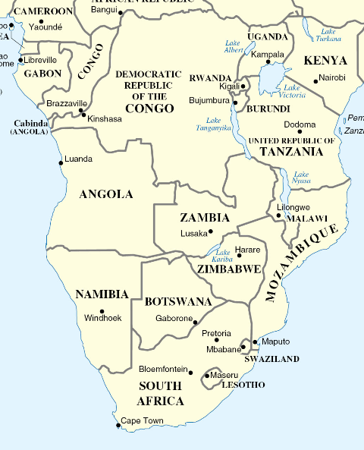
POLYTRA IN AFRICA
Present in Africa since 1974
100% owned by Polytra NV, Belgium (EU)
+ 120,000 MT / annum
Currently own offices in
5 DR Congo (Kolwezi, Lubumbashi, Kasumbalesa, Kinshasa, Matadi)
1 Zambia (Ndola)
1 South Africa (Durban)
1 Tanzania (Dar es Salaam)
Staff around 100 Fixed employees

Slide 4
POLYTRA AFRICA
Become THE reference for African Logistics by providing personalized services to every client.
Customs clearing
Ocean/Air freight
Handling/Warehousing
Inland Container Terminal
Road / Rail / Barge
Projects & engineering
Husbandry
Experienced and on the ground Managment and Supervision
Customized, tailored, cost-effective and timely Solutions
One-stop-shop Solutions
Continuous improvement through market follow-up, best practice sharing and location & routing studies.
Neutral transportation sourcing

Slide 5
POLYTRA Contact Details
Antwerp HQ :
Head of BD : Amaury Luyckx (Tel: + 32 3 205 04 73 | Cell: +32 472 18 92 74 )
Address : Potvlietlaan 7 | 2600 Berchem | Antwerp | Belgium
Email: aluyckx@polytra.be
DRC - Kinshasa – Matadi :
Manager : Marc Blampain (Cell: +243 858 182 222)
Address : Concession Gombe River - Avenue des Forces Armées Congolaises -1022 | Gombe | Kinshasa | R.D. Congo
Email: mblampain@polytra.be
DRC - Katanga - Lubumbashi :
Commercial Manager : George Iannou (SA Cell: + 27 72 432 45 04 // DRC Cell: +243 99 88 999 69 )
Ops Manager : Serge Kasongo (Cell: +243 997 023 190)
Address : Avenue Luvua 1 | Lubumbashi | D.R. Congo
Email: : gioannou@polytra.be // skasongo@polytra.be

Slide 6
Zambia – Ndola
Commercial Manager : George Iannou (SA Cell: + 27 72 432 45 04 // DRC Cell: +243 99 88 999 69 )
Ops Manager : Els Buyssens
Address : : Daniels Shopping Complex | Stand Number 7719 | Dag Hammerskjoeld, Itawa | Ndola | Zambia
Email: : gioannou@polytra.be // ebuysens@polytra.be
Tanzania – Dar Es Salaam
Commercial Manager : George Iannou (SA Cell: + 27 72 432 45 04 // DRC Cell: +243 99 88 999 69 )
Ops Manager : Jaskharan Chug (Cell : +255 685 701 862)
Address : : New TPA Stuffing Yard, 1- Bandari Road, Kurasini | Dar Es Salaam | Tanzania
Email: : gioannou@polytra.be // jchugh@polytra.be
South Afric- Durban
Commercial Manager : George Iannou (SA Cell: + 27 72 432 45 04 // DRC Cell: +243 99 88 999 69 )
Address : : Suite 950 I 9th Floor Mansion House I 12 Field Street I Durban 4000
Email: : gioannou@polytra.be

Slide 7
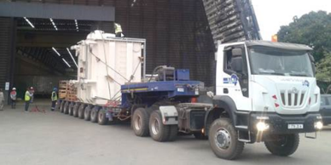
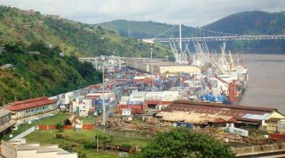
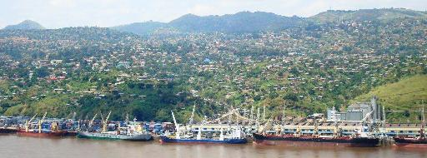
POLYTRA DRC – BAS-CONGO
Own Customs clearing licence (no external use)
Own offices in Matadi and Kinshasa
Excellent standing with various authorities
Dedicated hauling sub contractors into the area
Large experience with local customs procedures
Experience in Project Cargo to INGA
POLYTRA African Offices

Slide 8
POLYTRA DRC – KATANGA
40 Years Experience
Own secured Facility Yard
First fully dedicated Inland Container Depot (ICD) in the region
Own Customs clearing licence (no external use)
Own offices in Lubumbashi, Kasumbalesa, Kolwezi
Excellent standing with various authorities
Dedicated hauling sub contractors into the area
Large experience with local customs procedures
Own depot right at entry of Lubumbashi
200 x 200 mtr – 40.000 m2
Warehouse 20 x 20 mtr – 400 m2
Fully fenced with security
Separated bonded and non-bonded depots
Dedicated management and crew
Dedicated lifting equipment with back-up
Dedicated local delivery equipment
POLYTRA African Offices

Slide 9
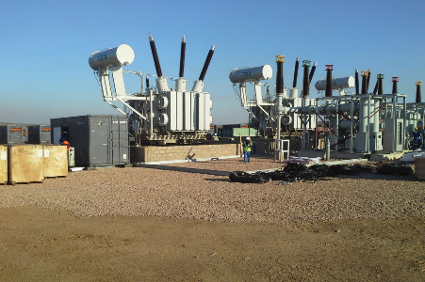
POLYTRA ZAMBIA
Own office – with dedicated personnel for Project supervision
Experience in Project Cargo and Handling
Dedicated hauling sub contractors into the area
Dedicated clearing contractors
POLYTRA African Offices

Slide 10
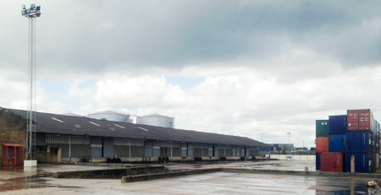
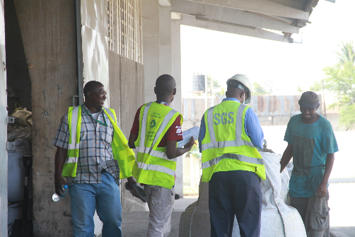
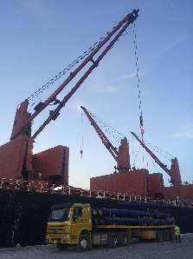
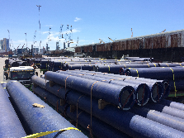
POLYTRA TANZANIA
Own office with dedicated and experienced Personnel
Dedicated depot at Dar es Salaam
200 x 50 mtr – 10.000 m2 - Warehouses +/- 2.800 m2
Fully fenced with security inside port area
Long term contract + strong relations with TPA (Tanzania Port Authorities)
Experience in big volume throughput for export
Experience in handling project cargo
POLYTRA African Offices

Slide 11
SERVICES IN SOUTH AFRICA
Co-Ownership with Polytra NV
Own office in Durban
Extensive experience beside standard cargo, in:
Bulk cargo
Project cargo
Specialised services
Sub-contracted agents in Zimbabwe, Botswana and Namibia
POLYTRA African Offices

Slide 12
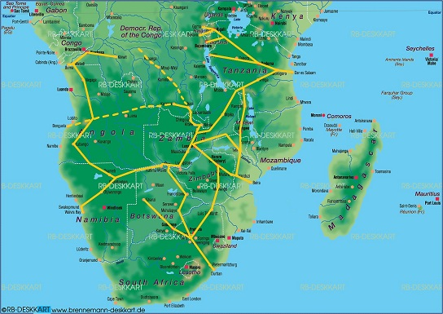
VARIOUS CORRIDORS TO OUR WAREHOUSE
Ex Walvis Bay – 1 or 2 border crossing – not many trucks
Ex Durban – 2 or 3 border crossings – plenty trucks
Ex Beira – 2 or 3 border crossings – not many trucks
Ex Dar es Salaam – 1 or 2 border crossing – plenty trucks

Slide 13
